Slide 1
pET29b+ ACS L641P GGSGGT His10
2014_04_10

Slide 2
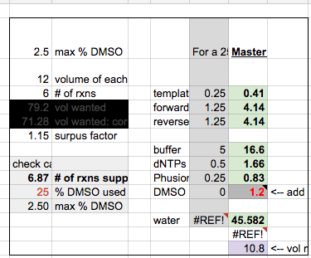
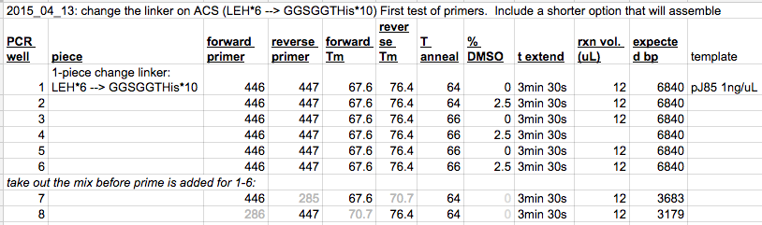
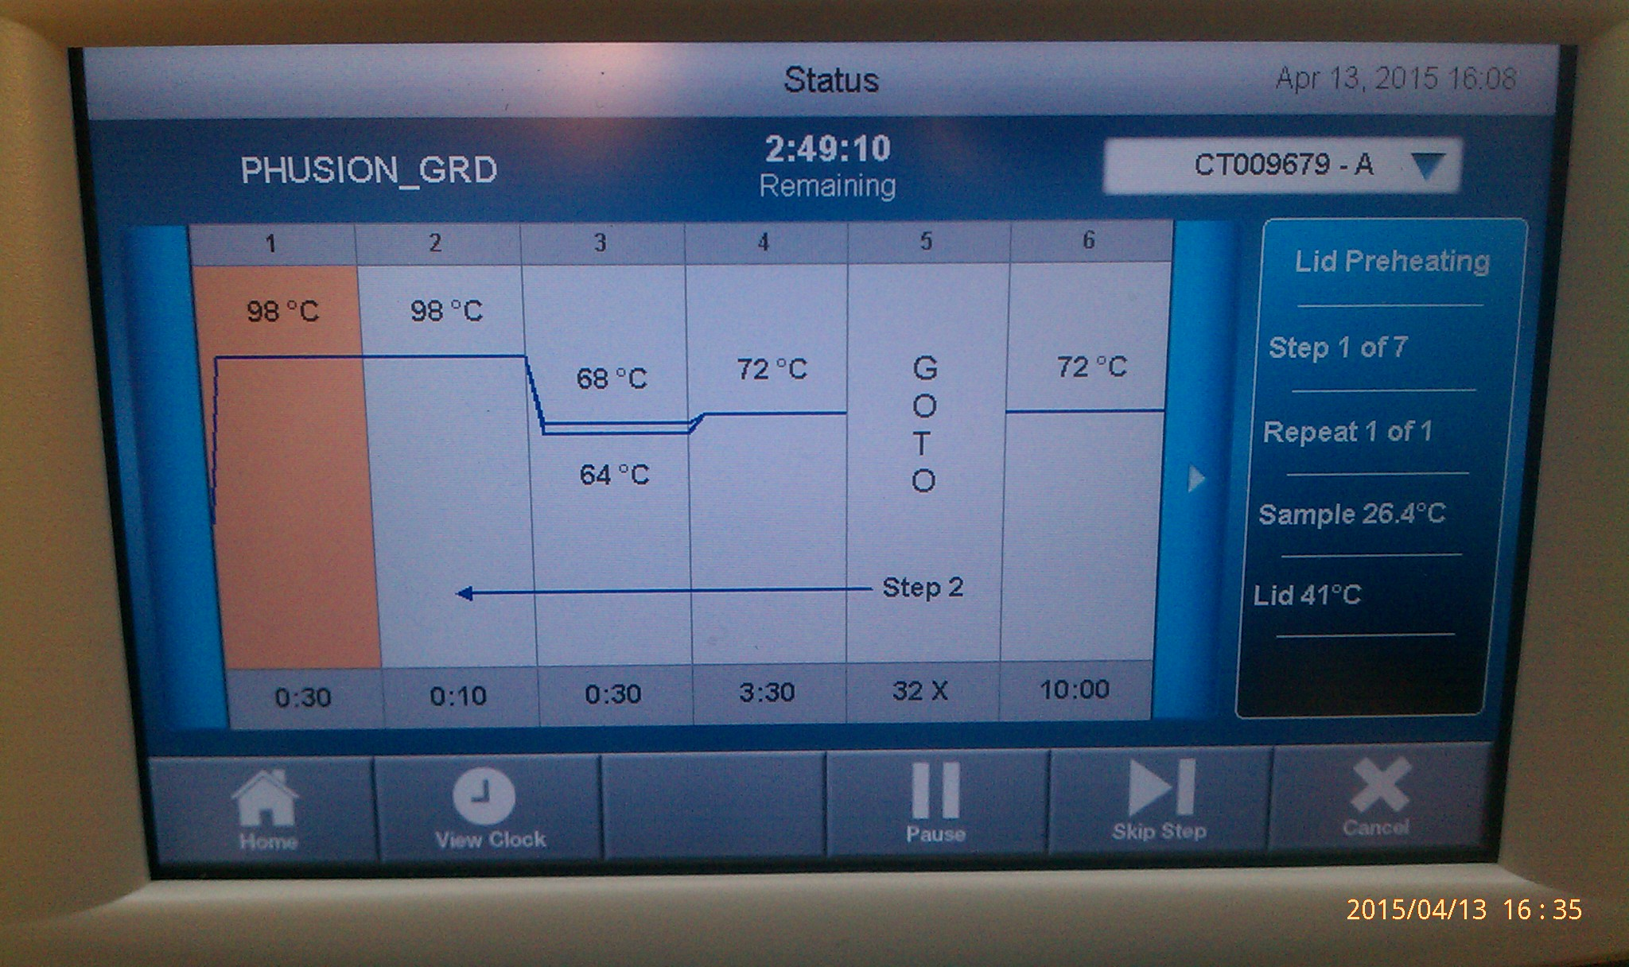
*
*
Will do as a 2-piece assembly!
Re-make purification scale products of 7 and 8.

Slide 3
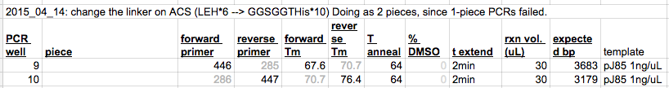
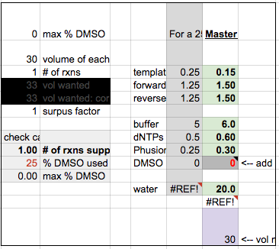
Run in Aaron’s thermocycler

Slide 4
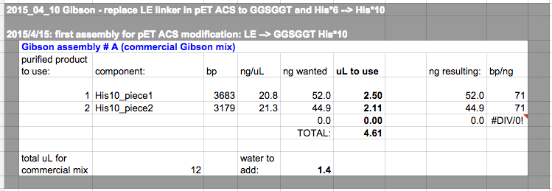
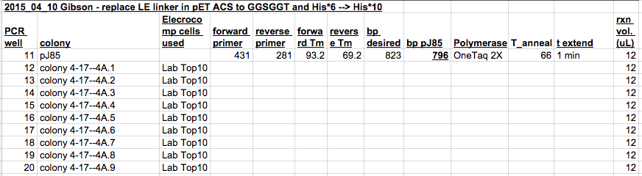
Transformed once 4/14, then desalted and re-transformed 4/16. Gave 9 colonies to screen.
2015_04_20 pic:
+ control
2
Send PCR product for 2 off.

